Slide 1
Soil
Desertification & Prevention
Soils of India
Land Use-Pattern in India

Slide 2
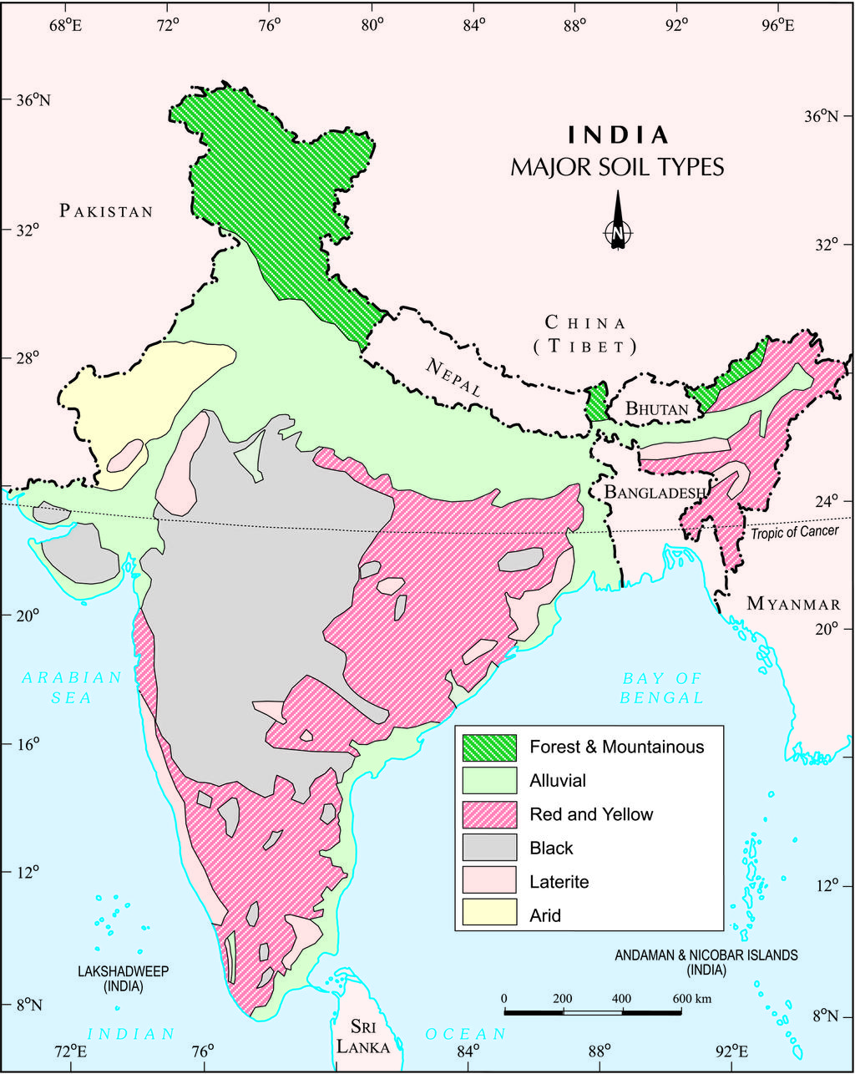
Soils of India
Alluvial soil
Red soil
Black soil
Lateritic soil
Mountainous soil
Desert soil
Saline –alkaline soil
Mangrove soil

Slide 3
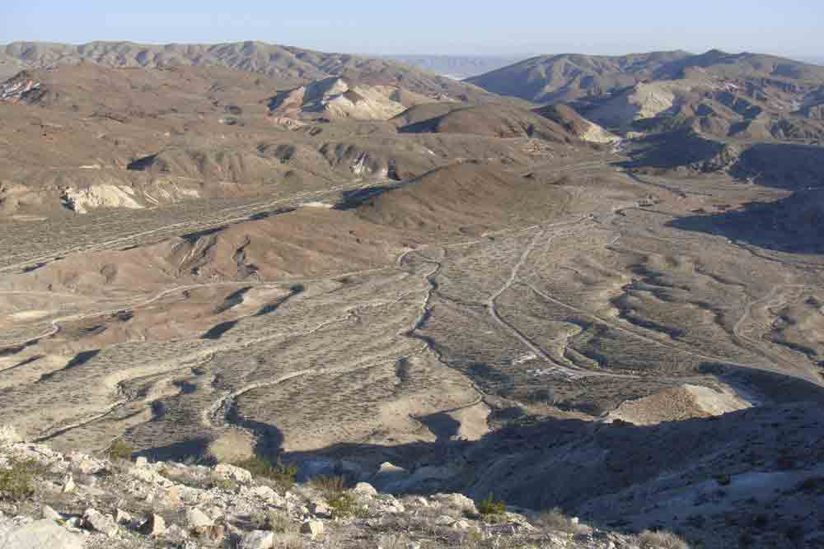
Alluvial soil
Covers 42% of Indian soil
Deposition of rivers
Most fertile
Rich in organic material, micro-nutrients, well-drained
Lacks Phosphorus

Slide 4
Alluvial soil
Northern Plains, east coast, GJ except Kathiawar
From East to west:
Fertility + Rainfall decrease
But Productivity + technological advancement increase

Slide 5
Alluvial soil
East India: high potential for 2nd Green revolution
Provide Irrigation + modern agro-practice
RJ plains: vulnerable to desertification, seepage from canal - salinity

Slide 6
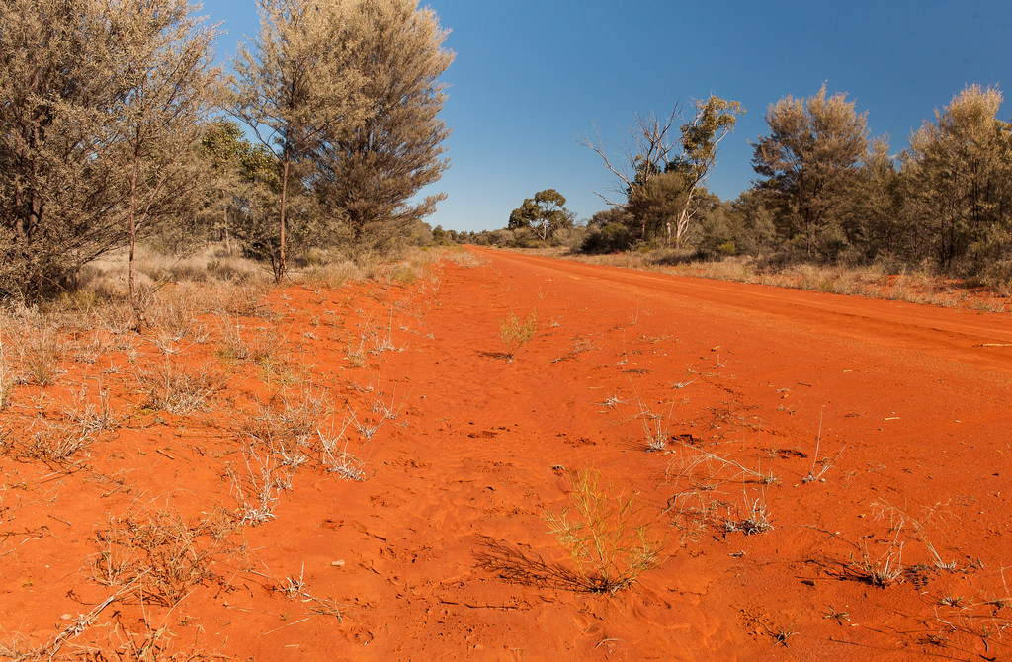
Red soil
Covers 25% of Indian soil area
Most wide-spread
Formed due to erosion of granite and Gneissic rocks having iron and Nickel
Best-drained soil-least susceptible to water-logging

Slide 7
Red Soil
Rich in lime, phosphate, iron, Potash, humus
But lack in Nitrogen and Phosphorus
It can support maximum crop-diversity
Important for food security and nutrition balance

Slide 8
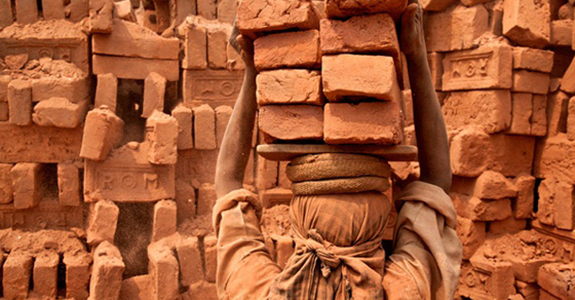
Red Soil
But most vulnerable to soil-erosion
Arid regions – drought –prone= poverty
Land fallowing
Brick-making –loss of top soil

Slide 9
UPSC
Question
Q. When you travel certain parts of India, you will notice red soil. What is the main reason for this colour?
Abundance of Magnesium
Accumulated humus
Presence of ferric oxide
Abundance of phosphate
Ans. C)
Prelims
2010

Slide 10
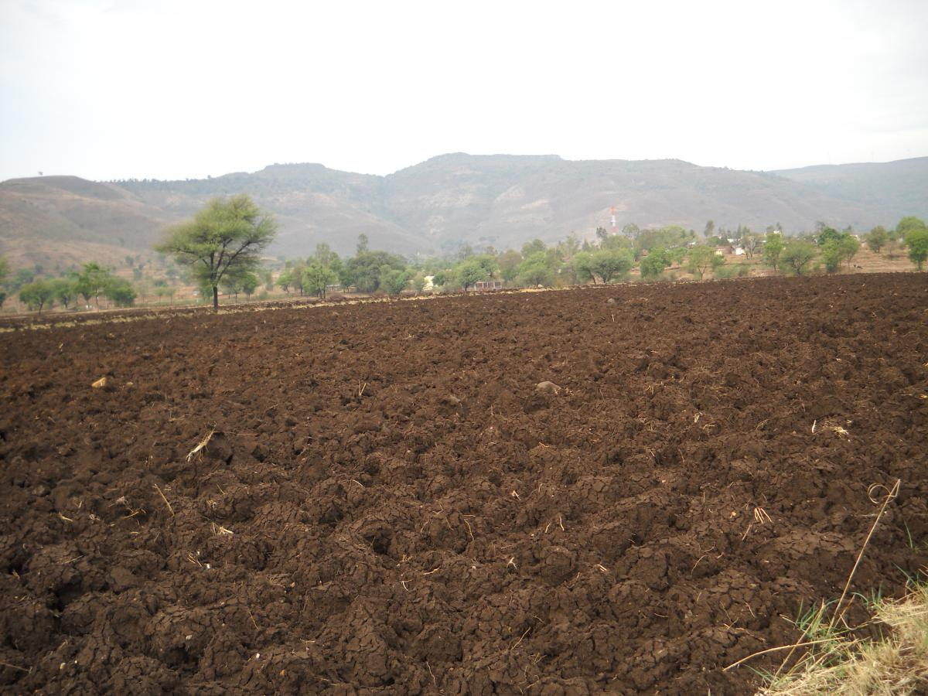
Black soil
Covers 15% of Indian soil
Weathering of lava rocks of Deccan plateau
Rich in Ferro-magnesium-silicate, lime and potash
Lack Nitrogen and Phosphorus

Slide 11
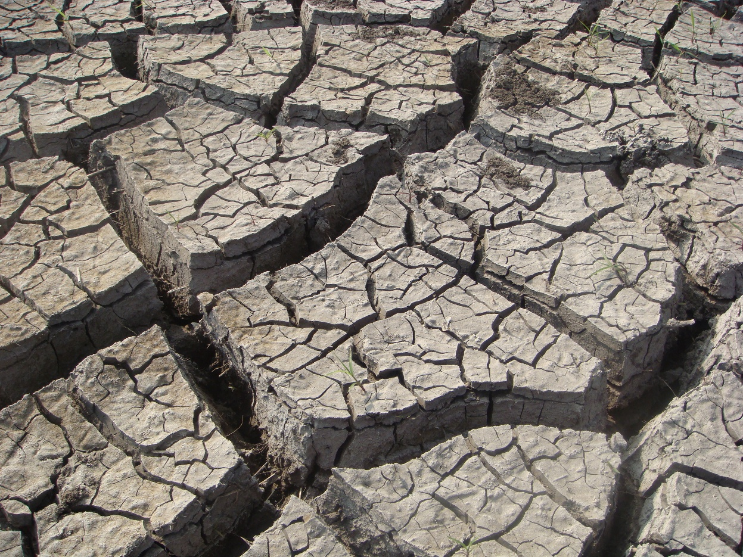
Black Soil
Unique property:
High clay content
Cracks when dry and sticky when wet
Cracks allow air to reach into depth
High water retentivity: good for cotton cultivation

Slide 12
Black Soil
Areas:
MH plateau, Kathiawar, Vindhyan, Kaimur hills
Northern part KN uplands

Slide 13
Minerals in Indian soil
Soil | Posses | lacks
Alluvial Soil | Nitrogen, Potash, humus | Poor in Phosphorus
Black soil | Potash and Humus | Poor in Nitrogen and Phosphorus
Red soil | Potash | N, P and humus
Laterite soil | Potash and Iron in excess | N, P and Calcium
Arid soil | High Calcium | N, humus
Saline | Sodium, Potassium in excess | N

Slide 14
Latosol (lateritic soil)
Covers 4.5% areas
Alternate wet-dry weather
Laterite = brick

Slide 15
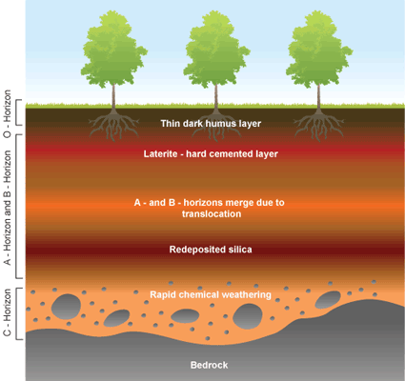
Latosol (lateritic soil)
Leaching of silica – iron remain in the top layer
Thick iron pans ‘Petlands’
Acidic soil
Quickly eroded on deforestation, mining and plantation

Slide 16
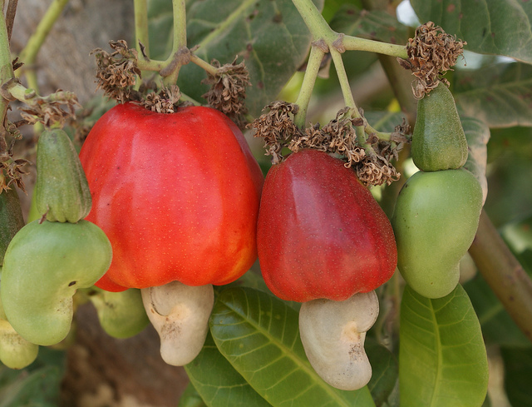
Lateritic soil: agriculture
Not suitable agriculture
But suitable for sp. Crops like Tapioca and cashew nuts
Rich in iron – support tea, coffee and rubber plantation with fertilizers

Slide 17
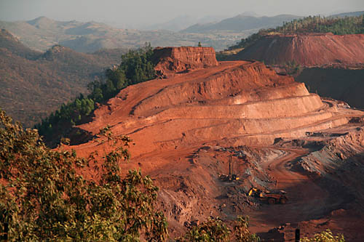
Latosol (lateritic soil)
Rich in Bauxite
Eastern Ghats, Telangana and KN plateau

Slide 18
UPSC
Question
Q. Which of the following statement regarding laterite soil of India are correct?
They are red in colour
They are rich in nitrogen and Potash
They are well developed in RJ and UP
Tapioca and Cashew nuts grow well on these soil
Prelims
2013

Slide 19
UPSC
Question
1,2 and 3
2,3 and 4
1 and 4
2 and 3
Ans. C)
Prelims
2013

Slide 20
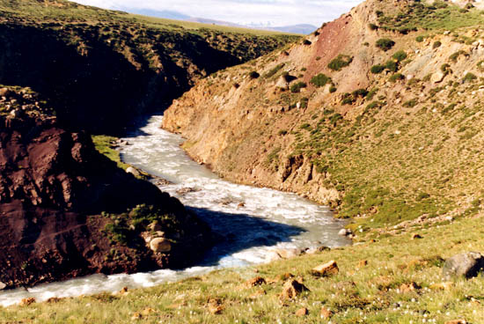
Mountainous soil
Very thin layer of soil
Under-developed soil horizon
Soil at steep gradient cannot support agriculture
Can support grassed of scrubs

Slide 21
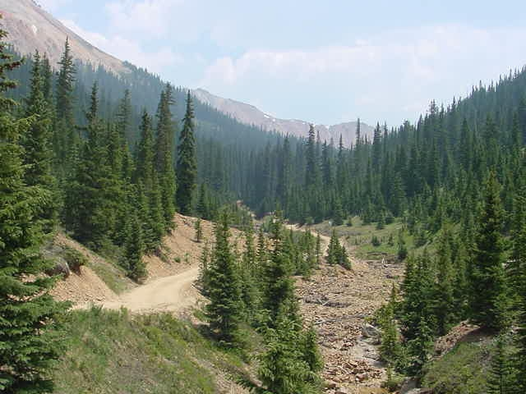
Mountainous soil
Podzolic soil
Under cold humid climate
Leaching of iron – silica remain at top soil
Not good for agriculture but good for forestry - lumbering

Slide 22
Mountainous soil
Chelation =
Leaves of coniferous trees covered with cheating agent – hard to degrade
Cold climate – slow bacterial process
Humus content is high

Slide 23
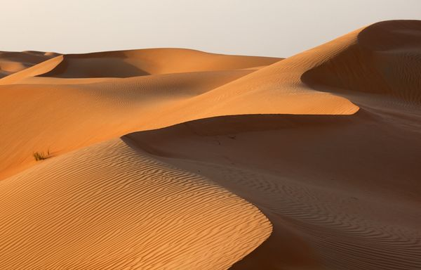
Desert Soil
Sandy, loose and friable soil
Coarse texture, low water holding capacity
Low nutrient, low fertility
Cannot support agriculture

Slide 24
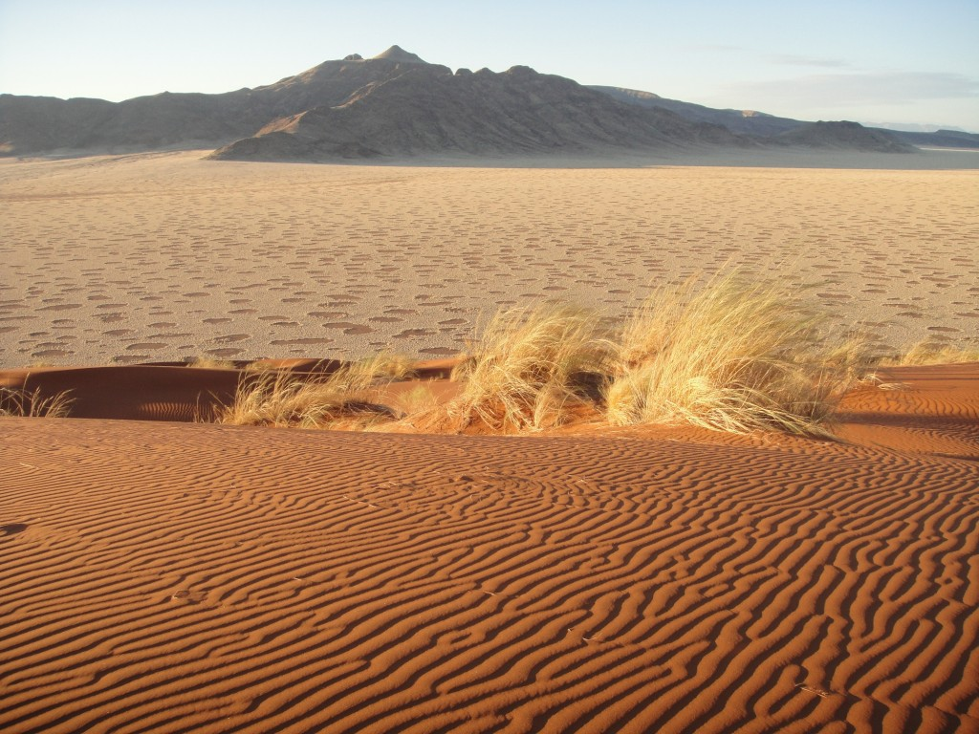
Desert soil
Indian desert soil is unique
Its made up of alluvium, fine loessic deposits
Good in micro-nutrients
Support agriculture under irrigation
Vulnerable to salinity and desertification

Slide 25
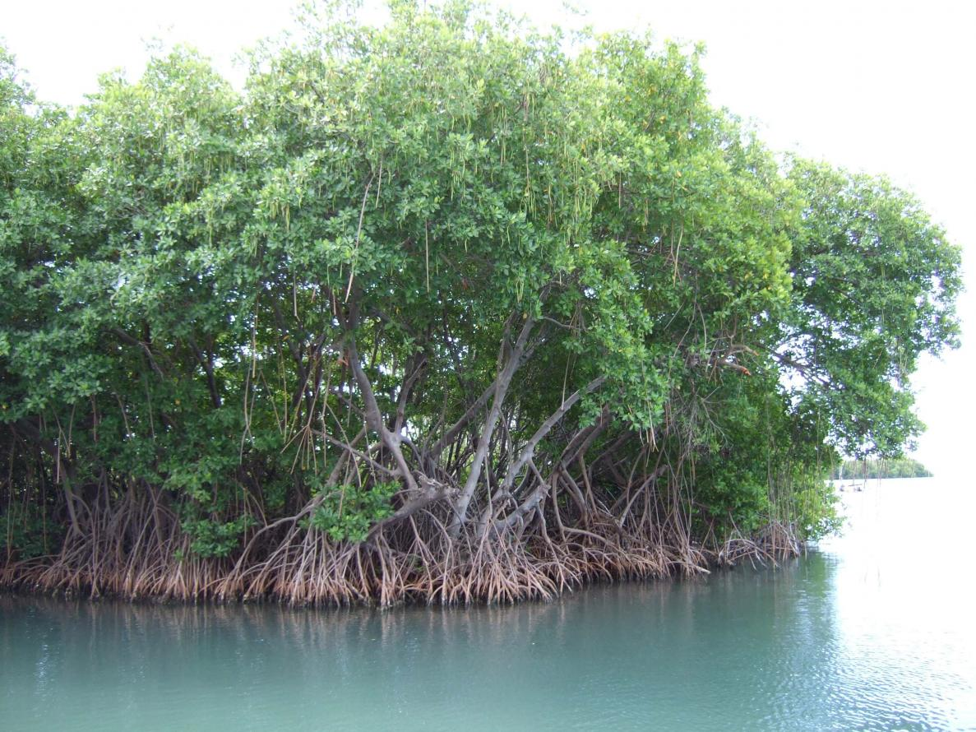
Mangrove soil
Along tidal region of coastal areas
Gleying process
Swampy-peaty soil
Bluish-green colour due to sulphide
Not suitable for agriculture – but support mangroves

Slide 26
Saline –Alkaline soil
Soil problem areas
Bad drainage in arid areas
Over-irrigation
Canal areas
West RJ, PN-HN, terai belt, Deccan region

Slide 27
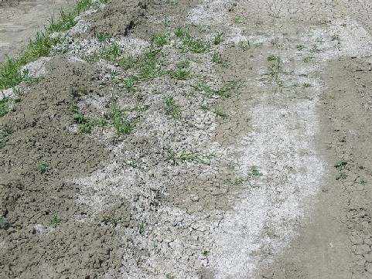
Saline –Alkaline soil
2 stages:
Calcification: moderate aridity condition
Calcium salts in upper layer
Saline soil: extreme arid condition
Sodium and Potassium salts in upper layer

Slide 28
Soil
Desertification & Prevention
Soils of India
Land Use-Pattern in India

Slide 29
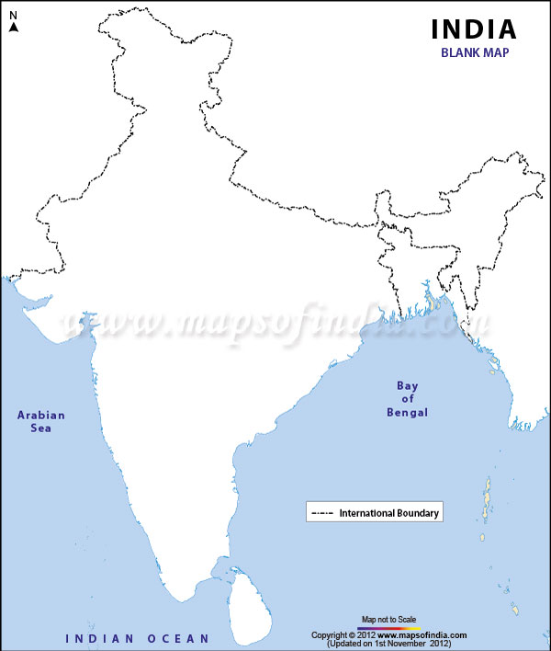
Land use pattern in India
Total geo area = 328 ml ha
Total reported area = 305 ml ha
India – 17% of world population on 2.4% of land
9 different ways of land use in India (Dept. Land resource)

Slide 30
Land use pattern in India
Land type | Usage in % of total reported area
Forest | 23% -25%
Net sown area | 46%
Land not available for agriculture Developmental land Wasteland | 15%
Fallow land | 12.5%
Pasture land | 3.5%
Trees and grooves | <1%

Slide 31
Desired Land use pattern in India
Land type | Usage in % of total reported area | Desired area
Forest | 23% -25%
Trees and grooves | <1%

Slide 32
Forest cover in India
Forest cover = 23-25%
Dense canopy forest = 8%
NACC – target forest cover- 33%
More forest = more rainfall = soil conservation = more ground water

Slide 33
Desired Land use pattern in India
Land type | Usage in % of total reported area | Desired area
Land not available for agriculture Developmental land | 15%

Slide 34
Need for Developmental land
As Indian economy grows, urbanization accelerate
Need more land to develop cities (100 Smart cities)
More Land needed for infrastructure (road, railway, bridges) and industries

Slide 35
Desired Land use pattern in India
Land type | Usage in % of total reported area | Desired area
Fallow land | 12.5%

Slide 36
Fallow land
Reason for fallow land:
Rainfed area: lack of irrigation facility
Poverty – lack of investment
Lack of knowledge to reclaim the land
Land under judicial litigation

Slide 37
Desired Land use pattern in India
Land type | Usage in % of total reported area | Desired area
Pasture land | 3.5%

Slide 38
Pastureland
India has largest cattle population in the world but not largest in dairy production
As disposable income of people increase – increase in demand of dairy products
Animal protein important to reduce Malnutrition, protein- deficiency
India has high potential to grow as dairy giant

Slide 39
Desired Land use pattern in India
Land type | Usage in % of total reported area | Desired area
Forest | 23% -25%
Trees and grooves | <1%
Developmental land | 15%
Pasture land | 3.5%

Slide 40
Desired Land use pattern in India
Land type | Usage in % of total reported area | Desired area
Net sown area | 46%

Slide 41
Net sown area in India
Net sown area (46%) ~ 141 ml ha
world’s 10% agriculture land
we need agriculture land for food security for large population
But to increase the production we do not need to increase the net sown area but need to increase productivity

Slide 42
Net sown area in India
China – largest grain producer + exporter
Its net sown area is 80 ml ha (India- 141 ml ha)
India has more natural potential for agriculture than China – fertile soil, tropical climate
So, marginal land must be released from agriculture – increase soil degradation

Slide 43
Net sown area in India
Use such land for afforestation or for development purpose
But protect fertile land from diverting to non-agriculture activity

Slide 44
Gross Sown Area
Total land under multiple cropping
India’s GSA ~ 199 ml ha
Out of 141 ml ha of net sown area only 58 ml ha of land grown more than once
Net Irrigated area = 63.6 ml ha
India needs to increase GSA and not NSA to increase productivity

Slide 45
Cropping Intensity
CI = GSA/NSA (%)
India’s CI = 140%
India’s target CI = 160 %
Highest CI in India – Punjab (~187%)

